Slide 1
Session 9 - Java Script
Adding Dynamic Content
to Web Pages

Slide 2
Agenda
Generating HTML Dynamically
Monitoring User Events
Basic JavaScript Syntax
Applications
  Using JavaScript to customize Web pages
  Using JavaScript to make pages more dynamic
  Using JavaScript to validate CGI forms
  Using JavaScript to manipulate HTTP cookies
  Using JavaScript to interact with and control frames
  Controlling applets and calling Java from JavaScript
  Accessing JavaScript from Java

Slide 3
Generating HTML Dynamically
Idea
  Script is interpreted as page is loaded, and uses document.write or document.writeln to insert HTML at the location the script occurs
Template
...
<BODY>
Regular HTML
<SCRIPT TYPE="text/javascript">
<!--
Build HTML Here
// -->
</SCRIPT>
More Regular HTML
</BODY>

Slide 4
A Simple Script
<!DOCTYPE HTML PUBLIC "-//W3C//DTD HTML 4.0//EN">
<HTML>
<HEAD>
<TITLE>First JavaScript Page</TITLE>
</HEAD>
<BODY>
<H1>First JavaScript Page</H1>
<SCRIPT TYPE="text/javascript">
<!--
document.write("<HR>");
document.write("Hello World Wide Web");
document.write("<HR>");
// -->
</SCRIPT>
</BODY>
</HTML>

Slide 5
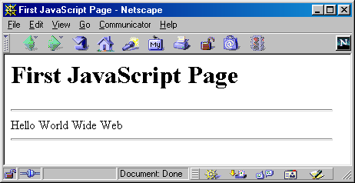
Simple Script, Result

Slide 6
Extracting Document Info with JavaScript, Example
<HTML>
<HEAD>
<TITLE>Extracting Document Info with JavaScript</TITLE>
</HEAD>
<BODY BGCOLOR="WHITE">
<H1>Extracting Document Info with JavaScript</H1>
<HR>
<SCRIPT TYPE="text/javascript">
<!--
function referringPage() {
if (document.referrer.length == 0) {
return("<I>none</I>");
} else {
return(document.referrer);
}
}

Slide 7
Extracting Document Info with JavaScript, Example, cont.
...
document.writeln
("Document Info:\n" +
"<UL>\n" +
" <LI><B>URL:</B> " + document.location + "\n" +
" <LI><B>Modification Date:</B> " + "\n" +
document.lastModified + "\n" +
" <LI><B>Title:</B> " + document.title + "\n" +
" <LI><B>Referring page:</B> " + referringPage() + "\n" +
"</UL>");
document.writeln
("Browser Info:" + "\n" +
"<UL>" + "\n" +
" <LI><B>Name:</B> " + navigator.appName + "\n" +
" <LI><B>Version:</B> " + navigator.appVersion + "\n" +
"</UL>");
// -->
</SCRIPT>
<HR>
</BODY>
</HTML>

Slide 8
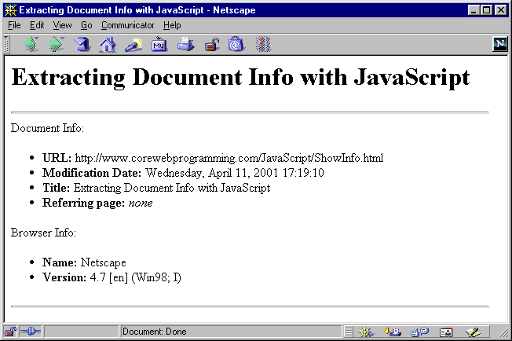
Extracting Document Info with JavaScript, Result

Slide 9
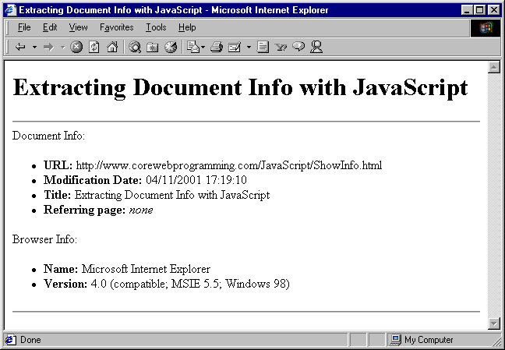
Extracting Document Info with JavaScript, Result

Slide 10
Multi-Browser Compatibility
Use Language Attribute
<SCRIPT LANGUAGE="JavaScript">
<!--
languageVersion = "1.0";
// -->
</SCRIPT>
<SCRIPT LANGUAGE="JavaScript1.1">
<!--
languageVersion = "1.1";
// -->
</SCRIPT>
...
<SCRIPT LANGUAGE="JavaScript1.5">
<!--
languageVersion = "1.5";
// -->
</SCRIPT>
Note: Don’t include that attribute TYPE="text/javascript"

Slide 11
Multi-Browser Compatibility, cont.
Use Vendor/Version Info
  navigator.appName
  navigator.appVersion

Slide 12
Monitoring User Events
Use Various onXxx Attributes
  onClick
  onLoad
  onMouseOver
  onFocus
  etc.

Slide 13
User Events, Example
<HTML>
<HEAD>
<TITLE>Simple JavaScript Button</TITLE>
<SCRIPT TYPE="text/javascript">
<!--
function dontClick() {
alert("I told you not to click!");
}
// -->
</SCRIPT>
</HEAD>
<BODY BGCOLOR="WHITE">
<H1>Simple JavaScript Button</H1>
<FORM>
<INPUT TYPE="BUTTON"
VALUE="Don't Click Me"
onClick="dontClick()">
</FORM>
</BODY>
</HTML>

Slide 14
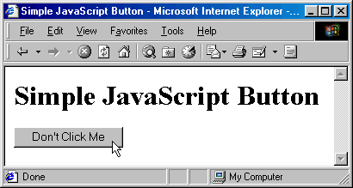
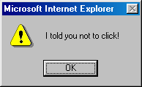
User Events, Result

Slide 15
JavaScript Syntax: Dynamic Typing
Idea
  Like Lisp, values are typed, not variables
  A value is only checked for proper type when it is operated upon
Example
var x = 5; // int
x = 5.5; // float
x = "five point five"; // String

Slide 16
JavaScript Syntax: Function Declarations
Declaration Syntax
  Functions are declared using the function reserved word
  The return value is not declared, nor are the types of the arguments
  Examples:
function square(x) {
return(x * x);
}
function factorial(n) {
if (n <= 0) {
return(1);
} else {
return(n * factorial(n - 1));
}
}

Slide 17
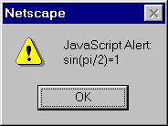
JavaScript Syntax: Function Declarations, cont.
First Class Functions
  Functions can be passed and assigned to variables
  Example
var fun = Math.sin;
alert("sin(pi/2)=" + fun(Math.PI/2));

Slide 18
JavaScript Syntax: Objects and Classes
Fields Can Be Added On-the-Fly
  Adding a new property (field) is a simple matter of assigning a value to one
  If the field doesn’t already exist when you try to assign to it, JavaScript will create it automatically.
  For instance:
var test = new Object();
test.field1 = "Value 1"; // Create field1 property
test.field2 = 7; // Create field2 property

Slide 19
JavaScript Syntax: Objects and Classes, cont.
You Can Use Literal Notation
  You can create objects using a shorthand “literal” notation of the form
{ field1:val1, field2:val2, ... , fieldN:valN }
  For example, the following gives equivalent values to object1 and object2
var object1 = new Object();
object1.x = 3;
object1.y = 4;
object1.z = 5;
object2 = { x:3, y:4, z:5 };

Slide 20
JavaScript Syntax: Objects and Classes, cont.
The "for/in" Statement Iterates Over Properties
  JavaScript, unlike Java or C++, has a construct that lets you easily retrieve all of the fields of an object
  The basic format is as follows:
for(fieldName in object) {
doSomethingWith(fieldName);
}
  Also, given a field name, you can access the field via object["field"] as well as via object.field

Slide 21
Field Iteration, Example
<!DOCTYPE HTML PUBLIC "-//W3C//DTD HTML 4.0 Transitional//EN">
<HTML>
<HEAD>
<TITLE>For/In Loops</TITLE>
<SCRIPT TYPE="text/javascript">
<!--
function makeObjectTable(name, object) {
document.writeln("<H2>" + name + "</H2>");
document.writeln("<TABLE BORDER=1>\n" +
" <TR><TH>Field<TH>Value");
for(field in object) {
document.writeln (" <TR><TD>" + field +
"<TD>" + object[field]);
}
document.writeln("</TABLE>");
}
// -->
</SCRIPT>

Slide 22
Field Iteration, Example
...
</HEAD>
<BODY BGCOLOR="WHITE">
<H1>For/In Loops</H1>
<SCRIPT TYPE="text/javascript">
<!--
var test = new Object();
test.field1 = "Field One";
test.field2 = "Field Two";
test.field3 = "Field Three";
makeObjectTable("test", test);
// -->
</SCRIPT>
</BODY>
</HTML>

Slide 23
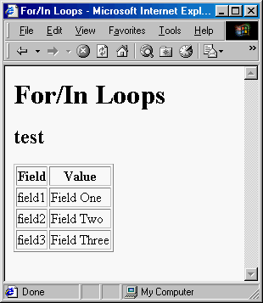
Field Iteration, Result
The for/in statement iterates over
object properties

Slide 24
JavaScript Syntax: Objects and Classes, cont.
A “Constructor” is Just a Function that Assigns to “this”
  JavaScript does not have an exact equivalent to Java’s class definition
  The closest you get is when you define a function that assigns values to properties in the this reference
  Calling this function using new binds this to a new Object
  For example, following is a simple constructor for a Ship class
function Ship(x, y, speed, direction) {
this.x = x;
this.y = y;
this.speed = speed;
this.direction = direction;
}

Slide 25
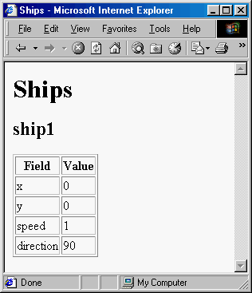
Constructor, Example
var ship1 =
new Ship(0, 0, 1, 90);
makeObjectTable("ship1", ship1);

Slide 26
JavaScript Syntax: Objects and Classes, cont.
Methods Are Function-Valued Properties
  No special syntax for defining methods of objects
  Instead, you simply assign a function to a property

Slide 27
Class Methods, Example
Consider a version of the Ship class that includes a move method
function degreesToRadians(degrees) {
return(degrees * Math.PI / 180.0);
}
function move() {
var angle = degreesToRadians(this.direction);
this.x = this.x + this.speed * Math.cos(angle);
this.y = this.y + this.speed * Math.sin(angle);
}
function Ship(x, y, speed, direction) {
this.x = x;
this.y = y;
this.speed = speed;
this.direction = direction;
this.move = move;
}

Slide 28
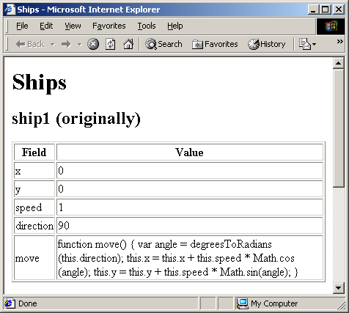
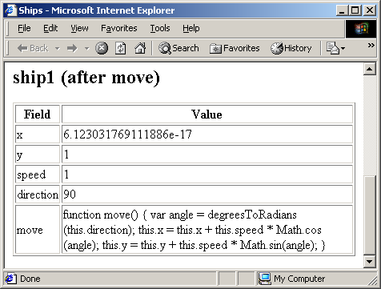
Class Methods, Result
var ship1 = new Ship(0, 0, 1, 90);
makeObjectTable("ship1 (originally)", ship1);
ship1.move();
makeObjectTable("ship1 (after move)", ship1);

Slide 29
JavaScript Syntax: Objects and Classes, cont.
Arrays
  For the most part, you can use arrays in JavaScript a lot like Java arrays.
    Here are a few examples:
  var squares = new Array(5);
  for(var i=0; i<squares.length; i++) {
  vals[i] = i * i;
  }
  // Or, in one fell swoop:
  var squares = new Array(0, 1, 4, 9, 16);
  var array1 = new Array("fee", "fie", "fo", "fum");
  // Literal Array notation for creating an array.
  var array2 = [ "fee", "fie", "fo", "fum" ];
  Behind the scenes, however, JavaScript simply represents arrays as objects with numbered fields
    You can access named fields using either object.field or object["field"], but numbered fields only via object[fieldNumber]

Slide 30
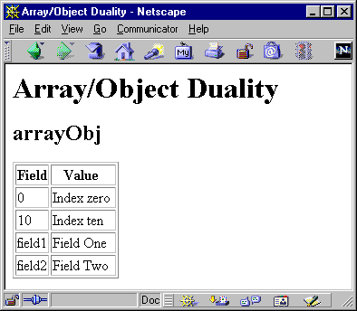
Array, Example
var arrayObj = new Object();
arrayObj[0] = "Index zero";
arrayObj[10] = "Index ten";
arrayObj.field1 = "Field One";
arrayObj["field2"] = "Field Two";
makeObjectTable("arrayObj",
arrayObj);

Slide 31
Application: Adjusting to the Browser Window Size
Netscape 4.0 introduced the window.innerWidth and window.innerHeight properties
  Lets you determine the usable size of the current browser window

Slide 32
Determining Browser Size, Example
<!DOCTYPE HTML PUBLIC "-//W3C//DTD HTML 4.0 Transitional//EN">
<HTML>
<HEAD>
<TITLE>Strawberries</TITLE>
<SCRIPT TYPE="text/javascript">
<!--
function image(url, width, height) {
return('<IMG SRC="' + url + '"' +
' WIDTH=' + width +
' HEIGHT=' + height + '>');
}
function strawberry1(width) {
return(image("Strawberry1.gif", width, Math.round(width*1.323)));
}
function strawberry2(width) {
return(image("Strawberry2.gif", width, Math.round(width*1.155)));
}
// -->
</SCRIPT>
</HEAD>

Slide 33
Determining Browser Size, Example, cont.
...
<SCRIPT TYPE="text/javascript">
<!--
var imageWidth = window.innerWidth/4;
var fontSize = Math.min(7, Math.round(window.innerWidth/100));
document.writeln
('<TABLE>\n' +
' <TR><TD>' + strawberry1(imageWidth) + '\n' +
' <TH><FONT SIZE=' + fontSize + '>\n' +
' "Doubtless God <I>could</I> have made\n' +
' a better berry, but doubtless He\n' +
' never did."</FONT>\n' +
' <TD>' + strawberry2(imageWidth) + '\n' +
'</TABLE>');
// -->
</SCRIPT>
<HR>
Strawberries are my favorite garden crop; a fresh ...
</BODY>
</HTML>

Slide 34
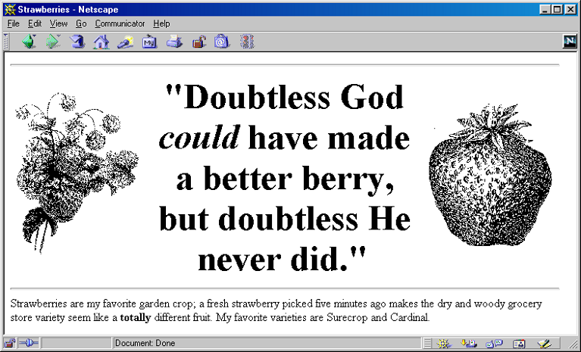
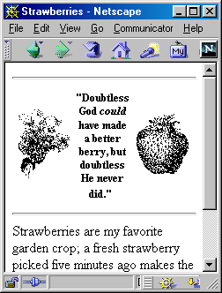
Determining Browser Size, Results

Slide 35
Application: Using JavaScript to Make Pages Dynamic
Modifying Images Dynamically
  The document.images property contains an array of Image objects corresponding to each IMG element in the current document
  To display a new image, simply set the SRC property of an existing image to a string representing a different image file

Slide 36
Modifying Images, Example
The following function changes the first image in a document
function changeImage() {
document.images[0].src = "images/new-image.gif";
}
Referring to images by name is easier:
<IMG SRC="cool-image.jpg" NAME="cool"
WIDTH=75 HEIGHT=25>
function improveImage() {
document.images["cool"].src = "way-cool.jpg";
}

Slide 37
Modifying Images: A Clickable Image Button, Example
<SCRIPT TYPE="text/javascript">
<!--
imageFiles = new Array("images/Button1-Up.gif",
"images/Button1-Down.gif",
"images/Button2-Up.gif",
"images/Button2-Down.gif");
imageObjects = new Array(imageFiles.length);
for(var i=0; i<imageFiles.length; i++) {
imageObjects[i] = new Image(150, 25);
imageObjects[i].src = imageFiles[i];
}
function setImage(name, image) {
document.images[name].src = image;
}

Slide 38
Modifying Images: A Clickable Image Button, Example
function clickButton(name, grayImage) {
var origImage = document.images[name].src;
setImage(name, grayImage);
var resetString =
"setImage('" + name + "', '" + origImage + "')";
setTimeout(resetString, 100);
}
// -->
</SCRIPT>
</HEAD>
...
<A HREF="location1.html"
onClick="clickButton('Button1', 'images/Button1-Down.gif')">
<IMG SRC="images/Button1-Up.gif" NAME="Button1"
WIDTH=150 HEIGHT=25></A>
<A HREF="location2.html"
onClick="clickButton('Button2', 'images/Button2-Down.gif')">
<IMG SRC="images/Button2-Up.gif" NAME="Button2"
WIDTH=150 HEIGHT=25></A>
...

Slide 39
Highlighting Images Under the Mouse, Example
<!DOCTYPE HTML PUBLIC "-//W3C//DTD HTML 4.0 Transitional//EN">
<HTML>
<HEAD>
<TITLE>High Peaks Navigation Bar</TITLE>
<SCRIPT TYPE="text/javascript">
<!—
// Given "Foo", returns "images/Foo.gif".
function regularImageFile(imageName) {
return("images/" + imageName + ".gif");
}
// Given "Bar", returns "images/Bar-Negative.gif".
function negativeImageFile(imageName) {
return("images/" + imageName + "-Negative.gif");
}

Slide 40
Highlighting Images Under the Mouse, Example, cont.
// Cache image at specified index. E.g., given index 0,
// take imageNames[0] to get "Home". Then preload
// images/Home.gif and images/Home-Negative.gif.
function cacheImages(index) {
regularImageObjects[index] = new Image(150, 25);
regularImageObjects[index].src =
regularImageFile(imageNames[index]);
negativeImageObjects[index] = new Image(150, 25);
negativeImageObjects[index].src =
negativeImageFile(imageNames[index]);
}
imageNames = new Array("Home", "Tibet", "Nepal",
"Austria", "Switzerland");
regularImageObjects = new Array(imageNames.length);
negativeImageObjects = new Array(imageNames.length);
// Put images in cache for fast highlighting.
for(var i=0; i<imageNames.length; i++) {
cacheImages(i);
}

Slide 41
Highlighting Images Under the Mouse, Example, cont.
...
function highlight(imageName) {
document.images[imageName].src = negativeImageFile(imageName);
}
function unHighlight(imageName) {
document.images[imageName].src = regularImageFile(imageName);
}
// -->
</SCRIPT>
</HEAD>
<BODY BGCOLOR="WHITE">
<TABLE BORDER=0 WIDTH=150 BGCOLOR="WHITE"
CELLPADDING=0 CELLSPACING=0>
<TR><TD><A HREF="Tibet.html"
TARGET="Main"
onMouseOver="highlight('Tibet')"
onMouseOut="unHighlight('Tibet')">
<IMG SRC="images/Tibet.gif"
NAME="Tibet"
WIDTH=150 HEIGHT=25 BORDER=0>
</A>
...

Slide 42
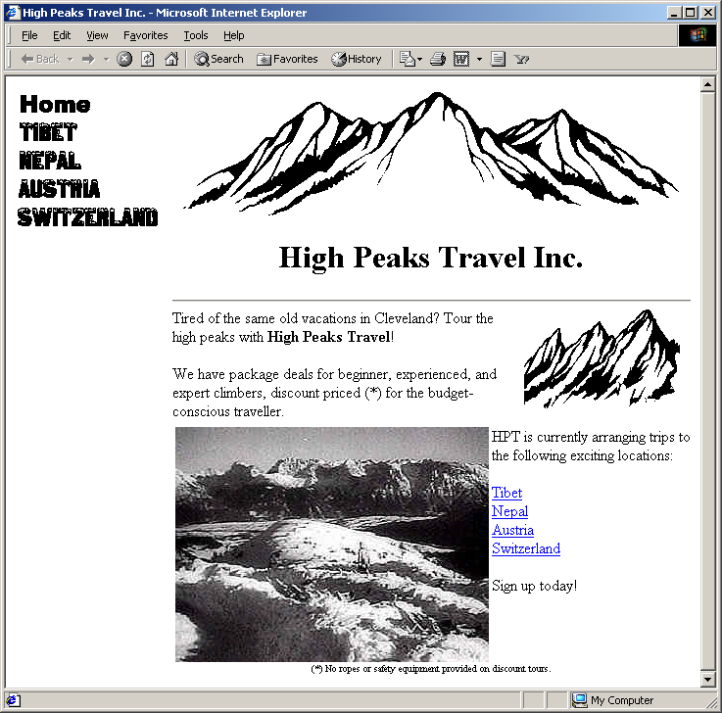

Highlighting Images Under the Mouse, Result

Slide 43
Making Pages Dynamic:
Moving Layers
Netscape 4 introduced “layers” – regions that can overlap and be positioned arbitrarily
JavaScript 1.2 lets you access layers via the document.layers array, each element of which is a Layer object with properties corresponding to the attributes of the LAYER element
A named layer can be accessed via document.layers["layer name"] rather than by using an index, or simply by using document.layerName

Slide 44
Moving Layers, Example
Descriptive overlays slowly “drift” to final spot when button clicked
<!DOCTYPE HTML PUBLIC "-//W3C//DTD HTML 4.0 Transitional//EN">
<HTML>
<HEAD>
<TITLE>Camps on K-3</TITLE>
<SCRIPT TYPE="text/javascript">
<!--
function hideCamps() {
// Netscape 4 document model.
document.layers["baseCamp"].visibility = "hidden";
document.layers["highCamp"].visibility = "hidden";
// Or document.baseCamp.visibility = "hidden";
}
function moveBaseCamp() {
baseCamp.moveBy(1, 3);
if (baseCamp.pageX < 130) {
setTimeout("moveBaseCamp()", 10);
}
}

Slide 45
Moving Layers, Example, cont.
function showBaseCamp() {
hideCamps();
baseCamp = document.layers["baseCamp"];
baseCamp.moveToAbsolute(0, 20);
baseCamp.visibility = "show";
moveBaseCamp();
}
function moveHighCamp() {
highCamp.moveBy(2, 1);
if (highCamp.pageX < 110) {
setTimeout("moveHighCamp()", 10);
}
}
function showHighCamp() {
hideCamps();
highCamp = document.layers["highCamp"];
highCamp.moveToAbsolute(0, 65);
highCamp.visibility = "show";
moveHighCamp();
}
// -->
</SCRIPT>

Slide 46
Moving Layers, Example, cont.
<LAYER ID="highCamp" PAGEX=50 PAGEY=100 VISIBILITY="hidden">
<TABLE>
<TR><TH BGCOLOR="WHITE" WIDTH=50>
<FONT SIZE="+2">High Camp</FONT>
<TD><IMG SRC="images/Arrow-Right.gif">
</TABLE>
</LAYER>
<LAYER ID="baseCamp" PAGEX=50 PAGEY=100 VISIBILITY="hidden">
<TABLE>
<TR><TH BGCOLOR="WHITE" WIDTH=50>
<FONT SIZE="+2">Base Camp</FONT>
<TD><IMG SRC="images/Arrow-Right.gif">
</TABLE>
</LAYER>
<FORM>
<INPUT TYPE="Button" VALUE="Show Base Camp"
onClick="showBaseCamp()">
<INPUT TYPE="Button" VALUE="Show High Camp"
onClick="showHighCamp()">
<INPUT TYPE="Button" VALUE="Hide Camps"
onClick="hideCamps()">
</FORM>

Slide 47
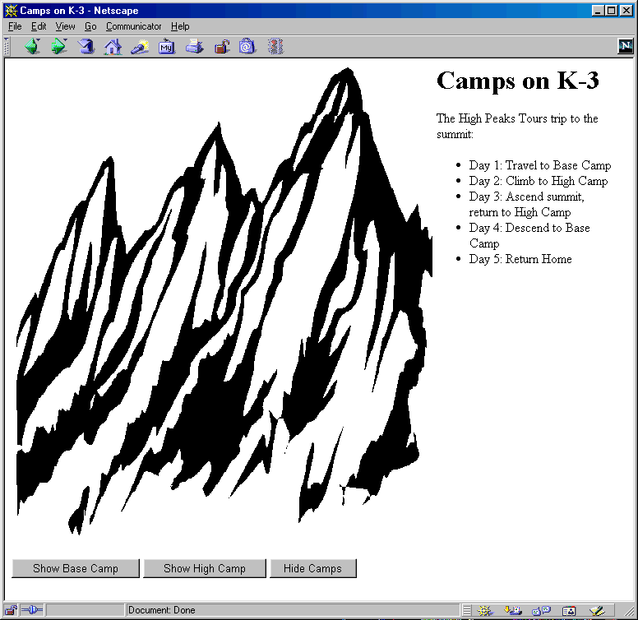
Moving Layers, Result

Slide 48
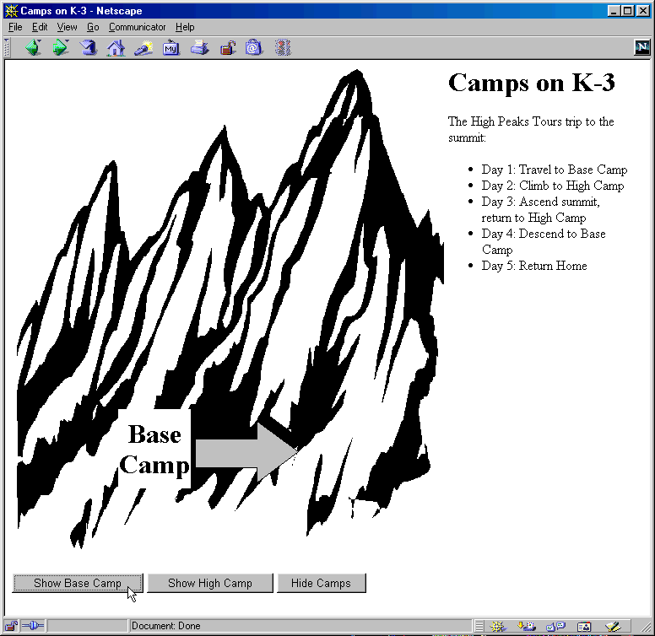
Moving Layers, Result

Slide 49
Application: Using JavaScript to Validate CGI Forms
Accessing Forms
  The document.forms property contains an array of Form entries contained in the document
  As usual in JavaScript, named entries can be accessed via name instead of by number, plus named forms are automatically inserted as properties in the document object, so any of the following formats would be legal to access forms
var firstForm = document.forms[0];
// Assumes <FORM NAME="orders" ...>
var orderForm = document.forms["orders"];
// Assumes <FORM NAME="register" ...>
var registrationForm = document.register;

Slide 50
Application: Using JavaScript to Validate CGI Forms, cont.
Accessing Elements within Forms
  The Form object contains an elements property that holds an array of Element objects
  You can retrieve form elements by number, by name from the array, or via the property name:
var firstElement = firstForm.elements[0];
// Assumes <INPUT ... NAME="quantity">
var quantityField = orderForm.elements["quantity"];
// Assumes <INPUT ... NAME="submitSchedule">
var submitButton = register.submitSchedule;

Slide 51
Checking Form Values Individually, Example
<!DOCTYPE HTML PUBLIC "-//W3C//DTD HTML 4.0 Transitional//EN">
<HTML>
<HEAD>
<TITLE>On-Line Training</TITLE>
<SCRIPT TYPE="text/javascript">
<!--
...
// When the user changes and leaves textfield, check
// that a valid choice was entered. If not, alert
// user, clear field, and set focus back there.
function checkLanguage() {
// or document.forms["langForm"].elements["langField"]
var field = document.langForm.langField;
var lang = field.value;
var prefix = lang.substring(0, 4).toUpperCase();
if (prefix != "JAVA") {
alert("Sorry, '" + lang + "' is not valid.\n" +
"Please try again.");
field.value = ""; // Erase old value
field.focus(); // Give keyboard focus
}
}

Slide 52
Checking Form Values Individually, Example, cont.
// -->
</SCRIPT>
</HEAD>
<BODY BGCOLOR="WHITE">
<H1>On-Line Training</H1>
<FORM ACTION="cgi-bin/registerLanguage" NAME="langForm">
To see an introduction to any of our on-line training
courses, please enter the name of an important Web
programming language below.
<P>
<B>Language:</B>
<INPUT TYPE="TEXT" NAME="langField"
onFocus="describeLanguage()"
onBlur="clearStatus()"
onChange="checkLanguage()">
<P>
<INPUT TYPE="SUBMIT" VALUE="Show It To Me">
</FORM>
</BODY>
</HTML>

Slide 53
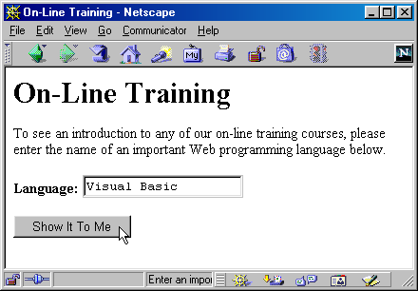
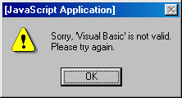
Checking Form Values Individually, Results

Slide 54
Checking Values When Form is Submitted, Example
<!DOCTYPE HTML PUBLIC "-//W3C//DTD HTML 4.0 Transitional//EN">
<HTML>
<HEAD>
<TITLE>Camp Registration</TITLE>
<SCRIPT TYPE="text/javascript">
<!--
function isInt(string) {
var val = parseInt(string);
return(val > 0);
}
function checkRegistration() {
var ageField = document.registerForm.ageField;
if (!isInt(ageField.value)) {
alert("Age must be an integer.");
return(false);
}
...
// Format looks OK. Submit form.
return(true);
}
// -->
</SCRIPT>

Slide 55
Checking Values When Form is Submitted, Example, cont.
<BODY BGCOLOR="WHITE">
<H1>Camp Registration</H1>
<FORM ACTION="cgi-bin/register"
NAME="registerForm"
onSubmit="return(checkRegistration())">
Age: <INPUT TYPE="TEXT" NAME="ageField"
onFocus="promptAge()"
onBlur="clearStatus()">
<BR>
Rank: <INPUT TYPE="TEXT" NAME="rankField"
onFocus="promptRank()"
onBlur="clearStatus()">
<BR>
Serial Number: <INPUT TYPE="TEXT" NAME="serialField"
onFocus="promptSerial()"
onBlur="clearStatus()">
<P>
<INPUT TYPE="SUBMIT" VALUE="Submit Registration">
</FORM>
</BODY>
</HTML>

Slide 56
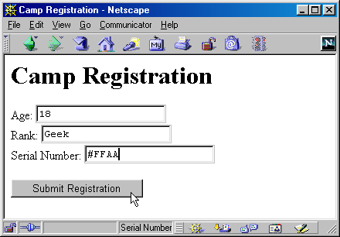
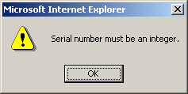
Checking Values When Form is Submitted, Results

Slide 57
Application: Using JavaScript to Store and Examine Cookies
Using document.cookies
  Set it (one cookie at a time) to store values
document.cookie = "name1=val1";
document.cookie = "name2=val2; expires=" + someDate;
document.cookie = "name3=val3; path=/; domain=test.com";
  Read it (all cookies in a single string) to access values

Slide 58
Application: Using JavaScript to Store and Examine Cookies
Parsing Cookies
function cookieVal(cookieName, cookieString) {
var startLoc = cookieString.indexOf(cookieName);
if (startLoc == -1) {
return(""); // No such cookie
}
var sepLoc = cookieString.indexOf("=", startLoc);
var endLoc = cookieString.indexOf(";", startLoc);
if (endLoc == -1) { // Last one has no ";"
endLoc = cookieString.length;
}
return(cookieString.substring(sepLoc+1, endLoc));
}

Slide 59
Cookie, Example
<!DOCTYPE HTML PUBLIC "-//W3C//DTD HTML 4.0 Transitional//EN">
<HTML>
<HEAD>
<TITLE>Widgets "R" Us</TITLE>
<SCRIPT TYPE="text/javascript">
<!--
function storeCookies() {
var expires = "; expires=Monday, 01-Dec-01 23:59:59 GMT";
var first = document.widgetForm.firstField.value;
var last = document.widgetForm.lastField.value;
var account = document.widgetForm.accountField.value;
document.cookie = "first=" + first + expires;
document.cookie = "last=" + last + expires;
document.cookie = "account=" + account + expires;
}
// Store cookies and give user confirmation.
function registerAccount() {
storeCookies();
alert("Registration Successful.");
}

Slide 60
Cookie, Example, cont.
function cookieVal(cookieName, cookieString) {
var startLoc = cookieString.indexOf(cookieName);
if (startLoc == -1) {
return(""); // No such cookie
}
var sepLoc = cookieString.indexOf("=", startLoc);
var endLoc = cookieString.indexOf(";", startLoc);
if (endLoc == -1) { // Last one has no ";"
endLoc = cookieString.length;
}
return(cookieString.substring(sepLoc+1, endLoc));
}
function presetValues() {
var firstField = document.widgetForm.firstField;
var lastField = document.widgetForm.lastField;
var accountField = document.widgetForm.accountField;
var cookies = document.cookie;
firstField.value = cookieVal("first", cookies);
lastField.value = cookieVal("last", cookies);
accountField.value = cookieVal("account", cookies);
}
// -->
</SCRIPT>

Slide 61
Cookie, Example, cont.
</HEAD>
<BODY BGCOLOR="WHITE" onLoad="presetValues()">
<H1>Widgets "R" Us</H1>
<FORM ACTION="servlet/cwp.Widgets"
NAME="widgetForm"
onSubmit="storeCookies()">
First Name: <INPUT TYPE="TEXT" NAME="firstField">
<BR>
Last Name: <INPUT TYPE="TEXT" NAME="lastField">
<BR>
Account Number: <INPUT TYPE="TEXT" NAME="accountField">
<BR>
Widget Name: <INPUT TYPE="TEXT" NAME="widgetField">
<BR>
<INPUT TYPE="BUTTON" VALUE="Register Account"
onClick="registerAccount()">
<INPUT TYPE="SUBMIT" VALUE="Submit Order">
</FORM>
</BODY>
</HTML>

Slide 62
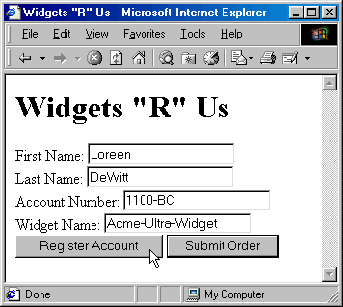
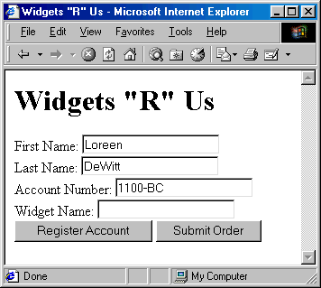
Cookie, Example, Result

Slide 63
Application: Using JavaScript to Interact with Frames
Idea
  The default Window object contains a frames property holding an array of frames (other Window objects) contained by the current window or frame.
    It also has parent and top properties referring to the directly enclosing frame or window and the top-level window, respectively.
    All of the properties of Window can be applied to any of these entries.

Slide 64
Displaying a URL in a Particular Frame, Example
ShowURL.html
<!DOCTYPE HTML PUBLIC "-//W3C//DTD HTML 4.0 Frameset//EN">
<HTML>
<HEAD>
<TITLE>Show a URL</TITLE>
</HEAD>
<FRAMESET ROWS="150, *">
<FRAME SRC="GetURL.html" NAME="inputFrame">
<FRAME SRC="DisplayURL.html" NAME="displayFrame">
</FRAMESET>
</HTML>

Slide 65
Displaying a URL in a Particular Frame, Example, cont.
GetURL.html
<HTML>
<HEAD>
<TITLE>Choose a URL</TITLE>
<SCRIPT TYPE="text/javascript">
<!--
function showURL() {
var url = document.urlForm.urlField.value;
// or parent.frames["displayFrame"].location = url;
parent.displayFrame.location = url;
}
function preloadUrl() {
if (navigator.appName == "Netscape") {
document.urlForm.urlField.value =
"http://home.netscape.com/";
} else {
document.urlForm.urlField.value =
"http://www.microsoft.com/";
}
}
...

Slide 66
Displaying a URL in a Particular Frame, Example, cont.
GetURL.html, cont.
<BODY BGCOLOR="WHITE" onLoad="preloadUrl()">
<H1 ALIGN="CENTER">Choose a URL</H1>
<CENTER>
<FORM NAME="urlForm">
URL: <INPUT TYPE="TEXT" NAME="urlField" SIZE=35>
<INPUT TYPE="BUTTON" VALUE="Show URL"
onClick="showURL()">
</FORM>
</CENTER>
</BODY>
</HTML>

Slide 67
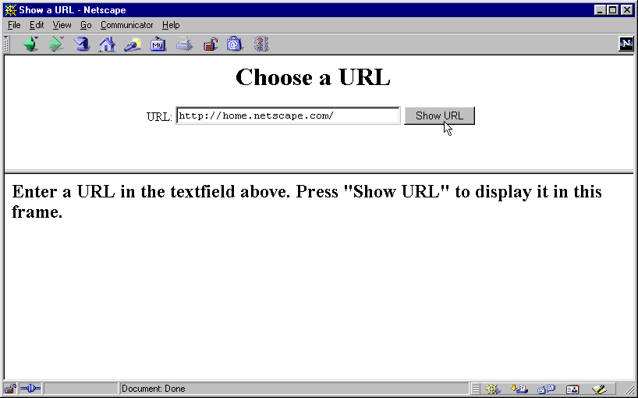
Displaying a URL in a Particular Frame, Result

Slide 68
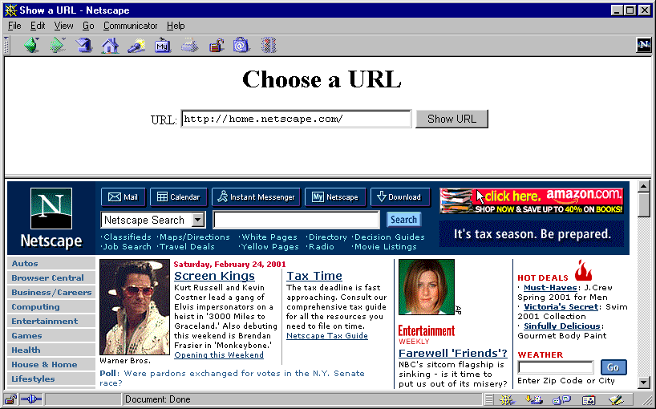
Displaying a URL in a Particular Frame, Result, cont.

Slide 69
Giving a Frame the Input Focus, Example
If JavaScript is manipulating the frames, the fix is easy: just add a call to focus in showUrl:
function showURL() {
var url = document.urlForm.urlField.value;
parent.displayFrame.location = url;
// Give frame the input focus
parent.displayFrame.focus();
}
Fixing the problem in regular HTML documents is a bit more tedious
  Requires adding onClick handlers that call focus to each and every occurrence of A and AREA that includes a TARGET, and a similar onSubmit handler to each FORM that uses TARGET

Slide 70
Application: Accessing Java from JavaScript
Idea
  Netscape 3.0 introduced a package called LiveConnect that allows JavaScript to talk to Java and vice versa
  Applications:
    Calling Java methods directly.
      In particular, this section shows how to print debugging messages to the Java console
    Using applets to perform operations for JavaScript
      In particular, this section shows how a hidden applet can be used to obtain the client hostname, information not otherwise available to JavaScript
    Controlling applets from JavaScript
      In particular, this section shows how LiveConnect allows user actions in the HTML part of the page to trigger actions in the applet

Slide 71
Application: Accessing Java from JavaScript
Calling Java Methods Directly
  JavaScript can access Java variables and methods simply by using the fully qualified name. For instance:
java.lang.System.out.println("Hello Console");
  Limitations:
    Can’t perform operations forbidden to applets
    No try/catch, so can’t call methods that throw exceptions
    Cannot write methods or create subclasses

Slide 72
Controlling Applets from JavaScript, Example
MoldSimulation.html, cont.
<BODY BGCOLOR="#C0C0C0">
<H1>Mold Propagation Simulation</H1>
<APPLET CODE="RandomCircles.class" WIDTH=100 HEIGHT=75>
</APPLET>
<P>
<APPLET CODE="RandomCircles.class" WIDTH=300 HEIGHT=75>
</APPLET>
<P>
<APPLET CODE="RandomCircles.class" WIDTH=500 HEIGHT=75>
</APPLET>
<FORM>
<INPUT TYPE="BUTTON" VALUE="Start Simulations"
onClick="startCircles()">
<INPUT TYPE="BUTTON" VALUE="Stop Simulations"
onClick="stopCircles()">
</FORM>
</BODY>
</HTML>

Slide 73
Controlling Applets from JavaScript, Example
MoldSimulation.html
<!DOCTYPE HTML PUBLIC "-//W3C//DTD HTML 4.0 Transitional//EN">
<HTML>
<HEAD>
<TITLE>Mold Propagation Simulation</TITLE>
<SCRIPT TYPE="text/javascript">
<!--
function startCircles() {
for(var i=0; i<document.applets.length; i++) {
document.applets[i].startCircles();
}
}
function stopCircles() {
for(var i=0; i<document.applets.length; i++) {
document.applets[i].stopCircles();
}
}
// -->
</SCRIPT>
</HEAD>

Slide 74
Controlling Applets from JavaScript, Example
RandomCircles.java
public class RandomCircles extends Applet
implements Runnable {
private boolean drawCircles = false;
public void startCircles() {
Thread t = new Thread(this);
t.start();
}
public void run() {
Color[] colors = { Color.lightGray, Color.gray,
Color.darkGray, Color.black };
int colorIndex = 0;
int x, y;
int width = getSize().width;
int height = getSize().height;
Graphics g = getGraphics();
drawCircles = true;
...

Slide 75
Controlling Applets from JavaScript, Example
RandomCircles.java, cont.
while(drawCircles) {
x = (int)Math.round(width * Math.random());
y = (int)Math.round(height * Math.random());
g.setColor(colors[colorIndex]);
colorIndex = (colorIndex + 1) % colors.length;
g.fillOval(x, y, 10, 10);
pause(0.1);
}
}
public void stopCircles() {
drawCircles = false;
}
private void pause(double seconds) {
try {
Thread.sleep((int)(Math.round(seconds * 1000.0)));
} catch(InterruptedException ie) {}
}
}

Slide 76
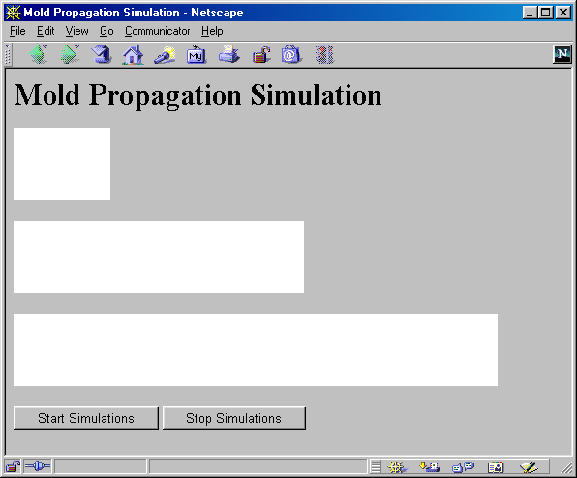
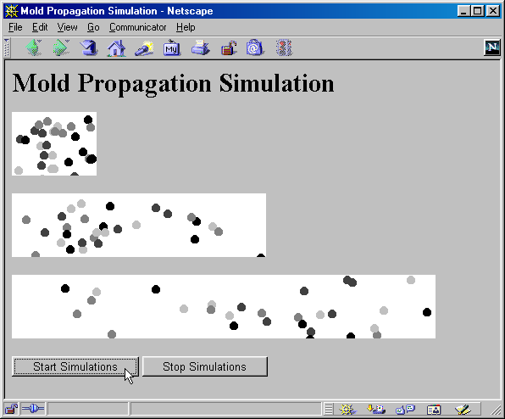
Controlling Applets from JavaScript, Results

Slide 77
Accessing JavaScript from Java
Steps
  Obtain and install the JSObject class
    Installed with Netscape 4 (javar40.jar)
    JDK 1.4 includes JSObject in jaws.jar
      See Chapter 24 in http://java.sun.com/j2se/1.4.1/docs/guide/plugin/developer_guide/contents.html
  Import it in your applet
    import netscape.javascript.JSObject
  From the applet, obtain a JavaScript reference to the current window
  JSObject window = JSObject.getWindow(this);

Slide 78
Accessing JavaScript from Java, cont.
Steps, cont.
  Read the JavaScript properties of interest
    Use getMember to access properties of the JSObject
    JSObject someForm =
    (JSObject)document.getMember("someFormName");
  Set the JavaScript properties of interest
    Use setMember to set properties of the JSObject
    document.setMember("bgColor", "red");
  Call the JavaScript methods of interest
  String[] message = { "An alert message" };
  window.call("alert", message);
  window.eval("alert(’An alert message’)");
  Give the applet permission to access its Web page
  <APPLET CODE=... WIDTH=... HEIGHT=... MAYSCRIPT>
  ...
  </APPLET>

Slide 79
Matching Applet Background with Web Page, Example
MatchColor.java
import java.applet.Applet;
import java.awt.*;
import netscape.javascript.JSObject;
public class MatchColor extends Applet {
public void init() {
JSObject window = JSObject.getWindow(this);
JSObject document =
(JSObject)window.getMember("document");
// E.g., "#ff0000" for red
String pageColor = (String)document.getMember("bgColor");
// E.g., parseInt("ff0000", 16) --> 16711680
int bgColor =
Integer.parseInt(pageColor.substring(1, 7), 16);
setBackground(new Color(bgColor));
}
}

Slide 80
Matching Applet Background with Web Page, Example, cont.
MatchColor.html
<HTML>
<HEAD>
<TITLE>MatchColor</TITLE>
</HEAD>
<BODY BGCOLOR="RED">
<H1>MatchColor</H1>
<APPLET CODE="MatchColor.class"
WIDTH=300 HEIGHT=300 MAYSCRIPT>
</APPLET>
</BODY>
</HTML>

Slide 81
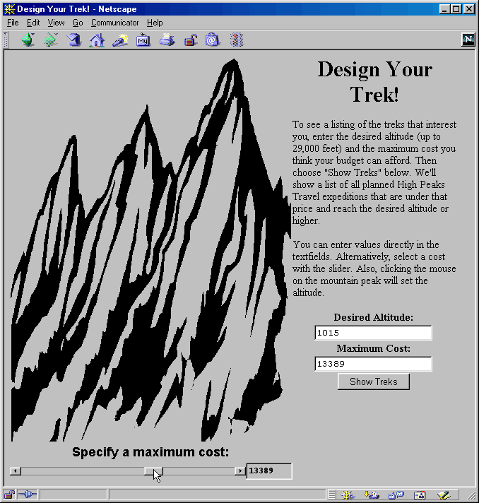
Applet That Controls HTML Form Values, Example
See on-line example for Everest.html

Slide 82
Summary
JavaScript permits you to:
  Customize Web pages based on the situation
  Make pages more dynamic
  Validate HTML form input
  Manipulate cookies
  Control frames
  Integrate Java and JavaScript

